Slide 1
Responsibility in the Classroom
Be prepared!
Do you have everything you need to do your work?
What does this look like?

Slide 2
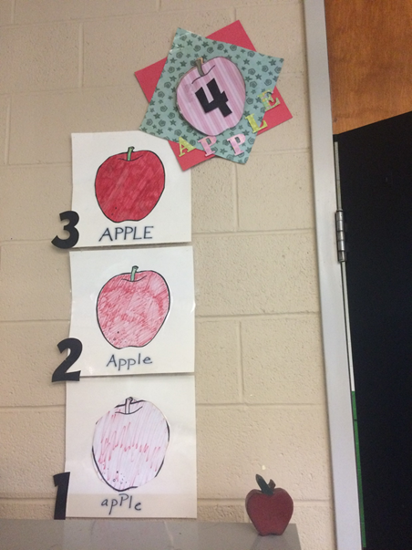
Responsibility in the Classroom
Do Your Best Work!
Are you showing “4 apple” work?

Slide 3
Responsibility in the Classroom
Transition quickly – don’t waste time.
Keep your things and work space neat and tidy.
"PBIS good vs bad examples"
"PBIS right way vs wrong way"
"PBIS whip nae nae"
Notes:
“PBIS good vs bad examples” classroom section starts at 6:06 and ends t 7:48.
“PBIS right way vs wrong way” video classroom setting starts at 6:06 and ends at 7:48
“PBIS whip nae nae” is a great overall video for Responsibility as well as Respect

